Slide 1

WATCH312
Mehak Sikka | msikka@andrew.cmu.edu
Krishma Parekh | krparekh@andrew.cmu.edu
Muhammad Waqas Aziz | maziz2@andrew.cmu.edu
Muhammad Awais | mawais@andrew.cmu.edu
Ahsan Saeed | asaeed@andrew.cmu.edu

Slide 2
AGENDA
Vision
Team
Problem
Approach / Solution
Market
Business Model
Competition
Go-to-Market

Slide 3

VISION: WE HELP CHOOSE THE IDEAL NEIGHBOURHOOD FOR YOU IN CHICAGO!

Slide 4
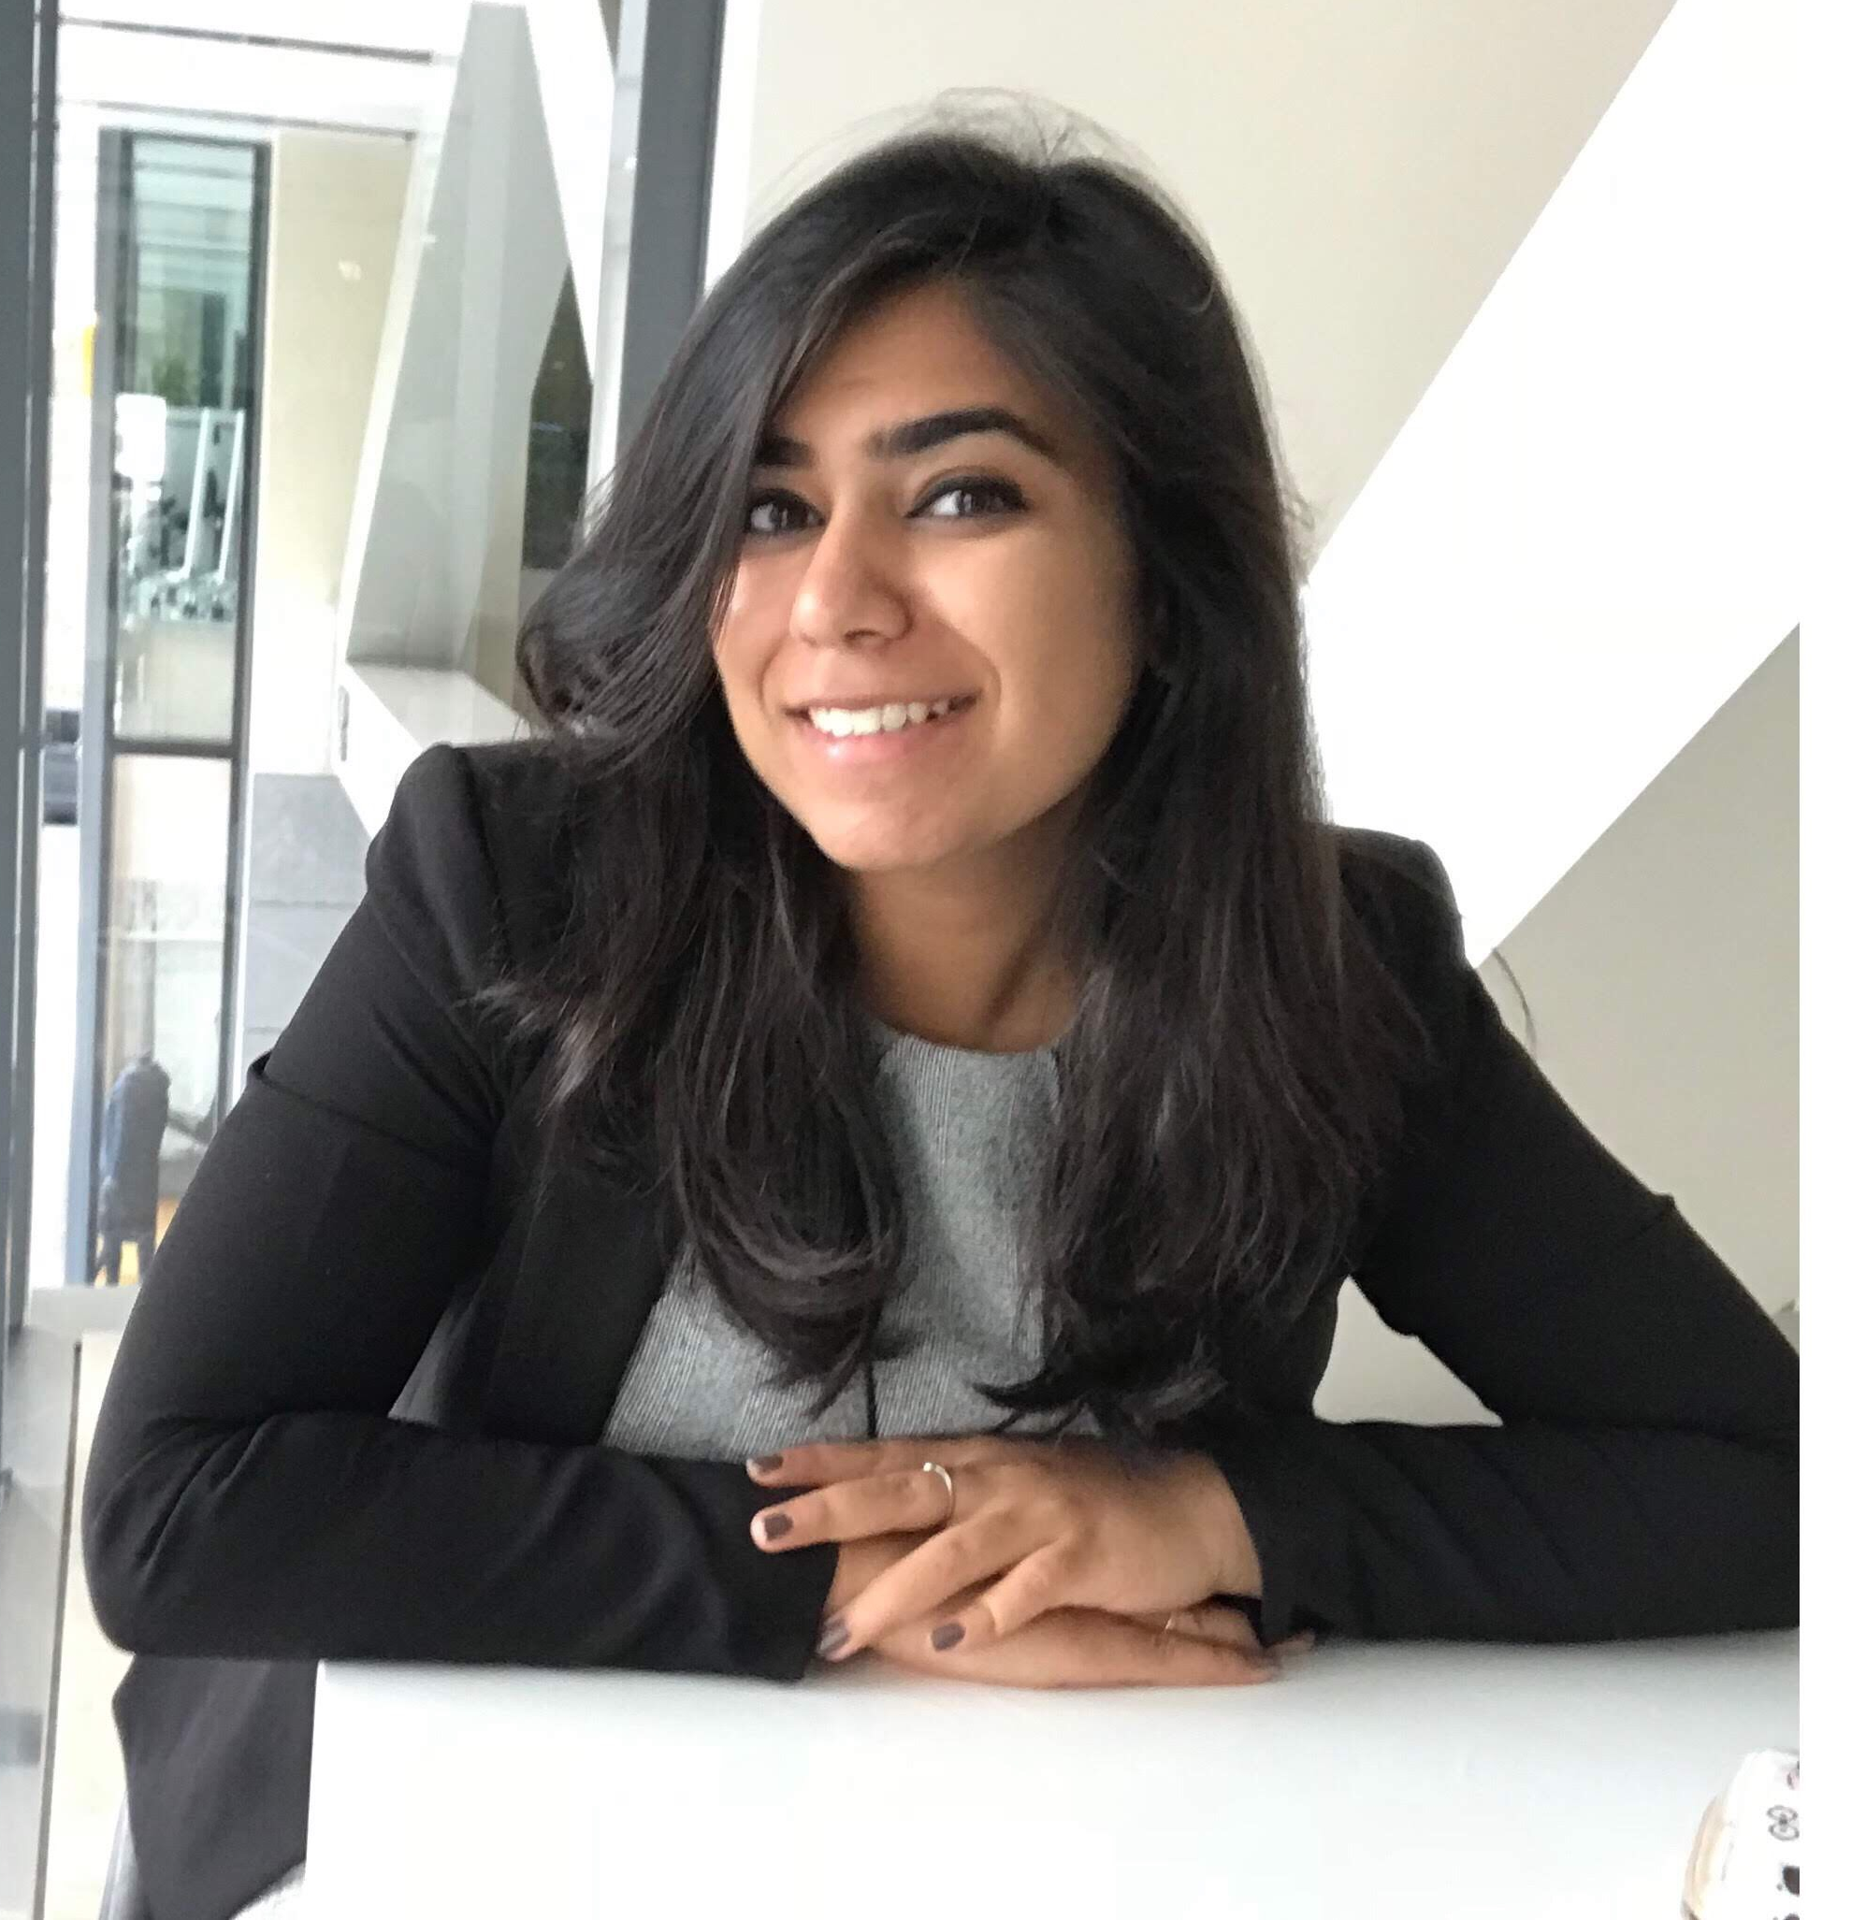


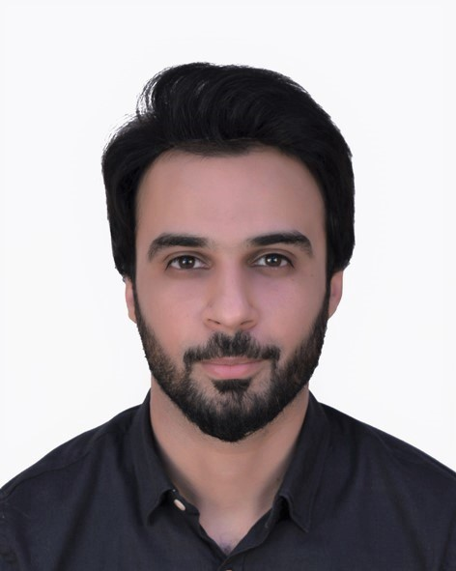
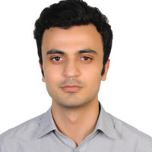
TEAM
Mehak Sikka
https://www.linkedin.com/in/mehaksikka/
Krishma Parekh
https://www.linkedin.com/in/mehaksikka/
Muhammad Awais
https://www.linkedin.com/in/awais211/
Muhammad Waqas Aziz
https://www.linkedin.com/in/muhammad-waqas-aziz/
Ahsan Saeed
https://www.linkedin.com/in/ahsansaeedakhtar/

Slide 5

PROBLEM (CUSTOMER PAIN)
Buying a home is all about doing your homework. It is not only time consuming but is also hard to find a solution tailored according to your preferences.
Currently there are abundant sources out there which does not guarantee any reliability. People use different websites and sources to answer a single question – which neighborhood should they move to?
There is a dire need of a customized one-stop solution for neighborhood selection which not only saves time but also uses data from reliable sources

Slide 6

SOLUTION / PRODUCT
WATCH312 provides customers access to reliable data of all neighborhoods in Chicago solving their ultimate dilemma of house hunting.
The product customizes the results based on customer needs such as price, health factor, education and crime rate.
It also saves customers the time, energy and cost of dealing with agents and other non-reliable sources by bringing together data from various trustworthy data sources.

Slide 7

MARKET
People looking to stay in protected and safe areas for themselves.
People who are buying houses for the first time.
People who are moving into a new state or have shifted due to jobs or family reasons.
Everyone who wants to understand where they could get houses suitable to their preferences.
Every year 100,000 houses are purchased in the city of Chicago.
People look for houses all through the year. The market of people who would use this application would be 3 times more.

Slide 8
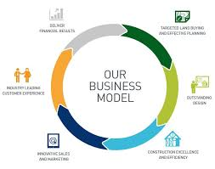
BUSINESS MODEL / UNIT ECONOMICS
Revenue generation
Advertising will be the key source of income
Specialized reports with in-depth analysis of the neighborhood at an additional cost
Pricing details
Free of cost for users – pricing for specialized reports based on market survey

Slide 9
COMPETITION
There is only one organization which provides similar level of comprehensive information about neighborhood:
Neighborhood Scout:
neighborhoodscout.com
How are we differentiated?
Neighborhood Scout uses very few indicators. We will incorporate a broader set of customer needs
Also, we have a specialized application for Chicago compared to Neighborhood Scout which is a generic application

Slide 10
Data Sources and Application Development

Slide 11
Based on research, we found that decision to buy/rent house in a neighborhood is made on five characteristics
1
HEALTH
2
ENVIRONMENT
3
CRIME
4
EDUCATION
5
PRICES

Slide 12
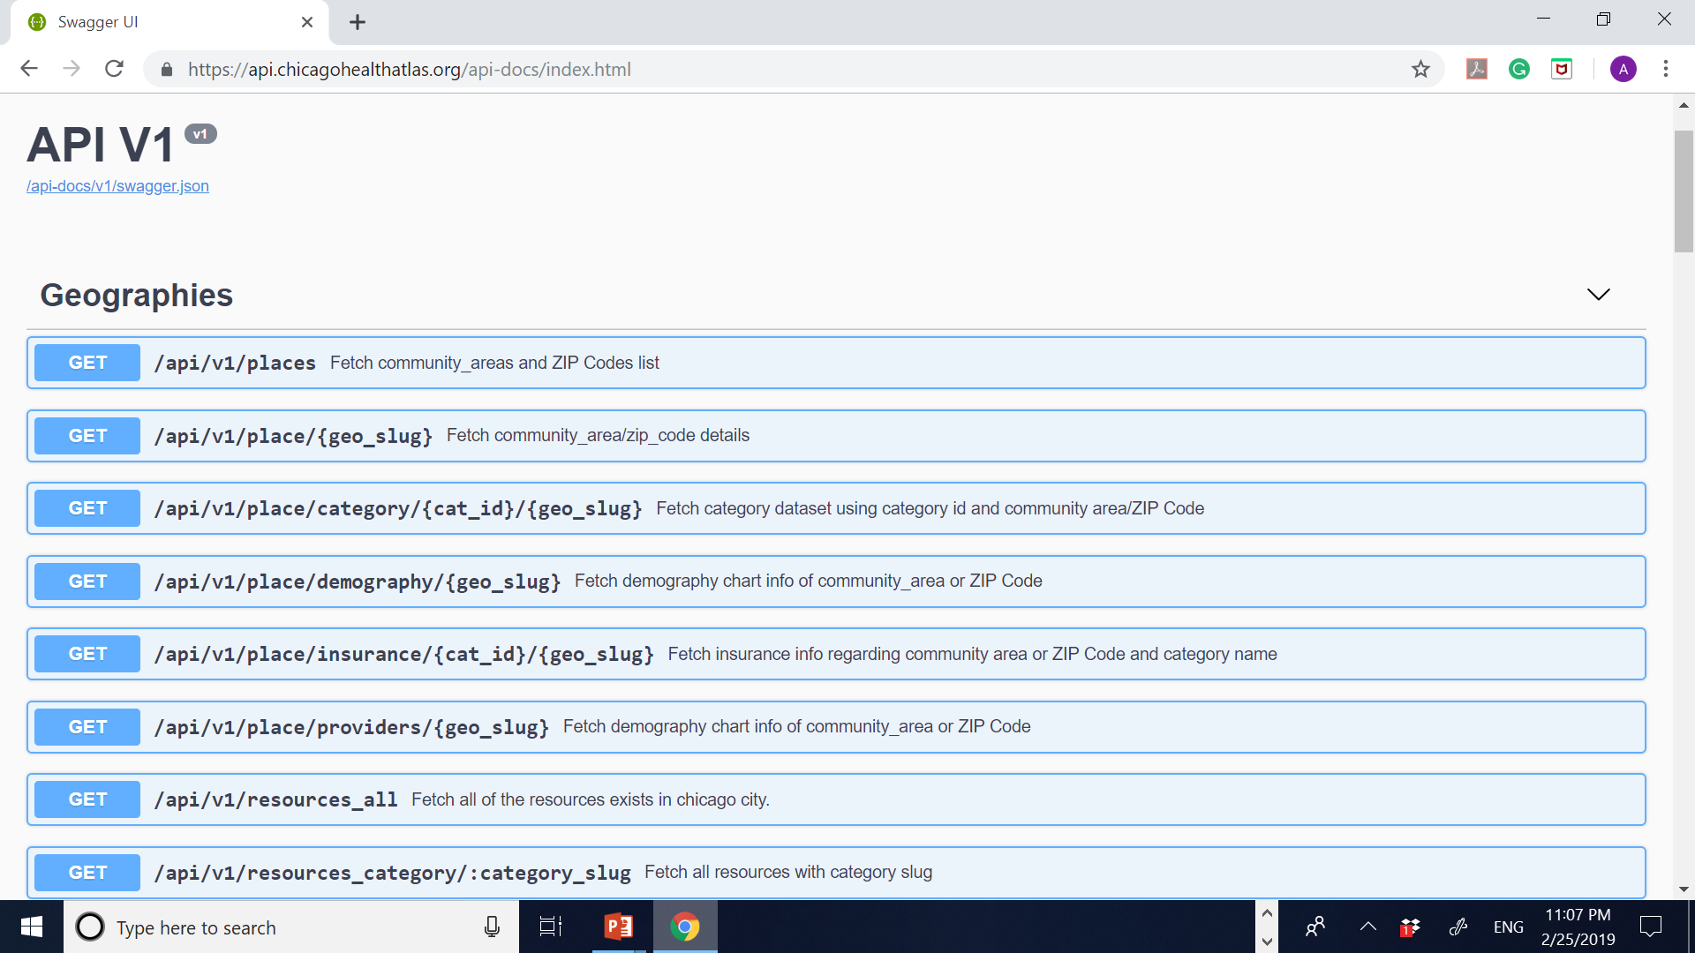
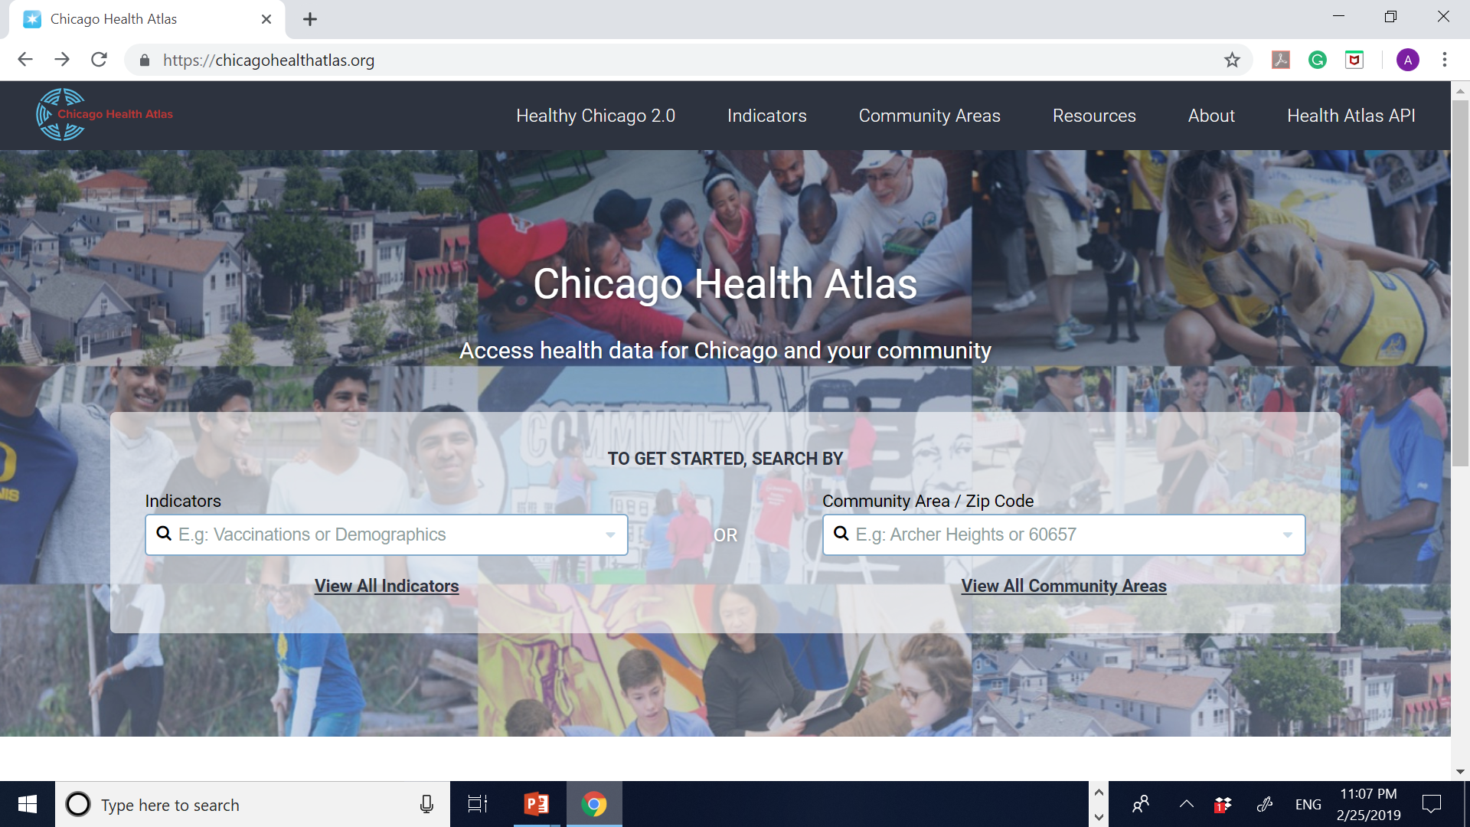
HEALTH DATA: CHICAGO HEALTH ATLAS - API

Slide 13
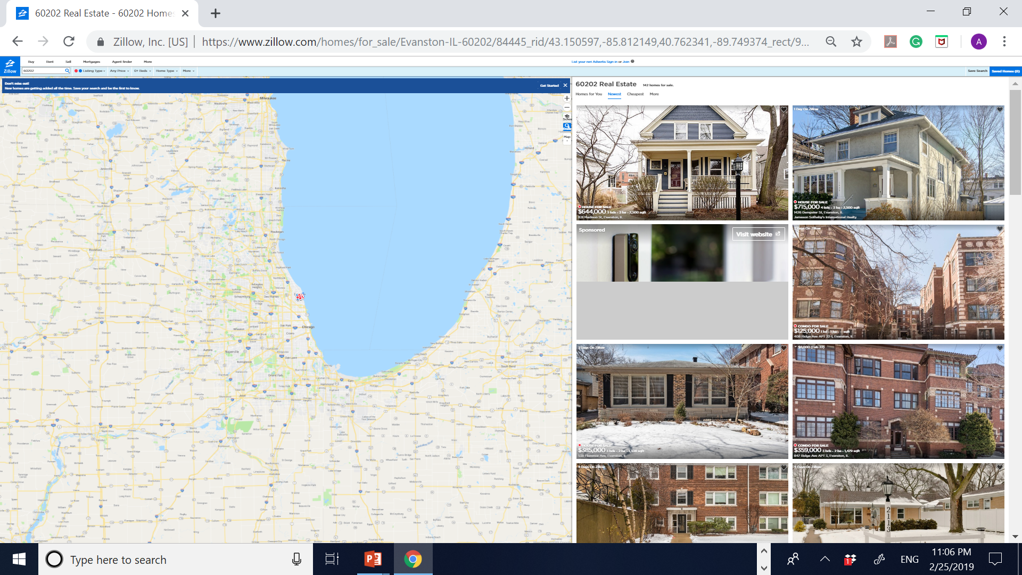
ENVIRONMENT DATA: ZILLOW – WEB SCRAPPING

Slide 14
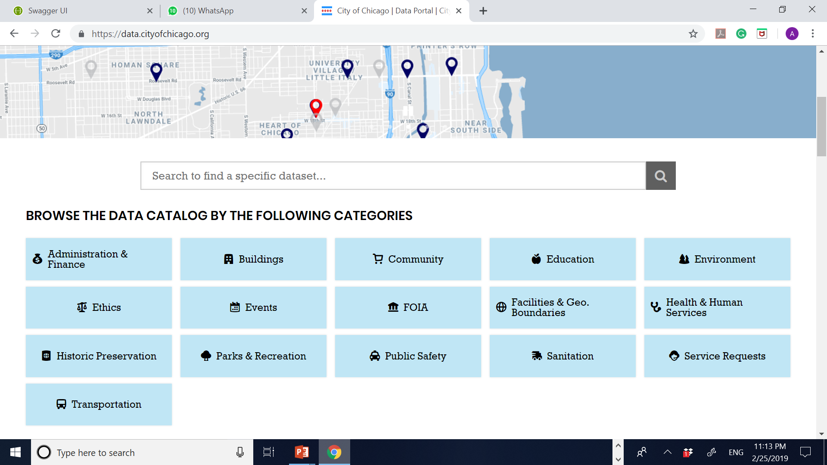
CRIME: CHICAGO CITY – API & WEB SCRAPPING

Slide 15
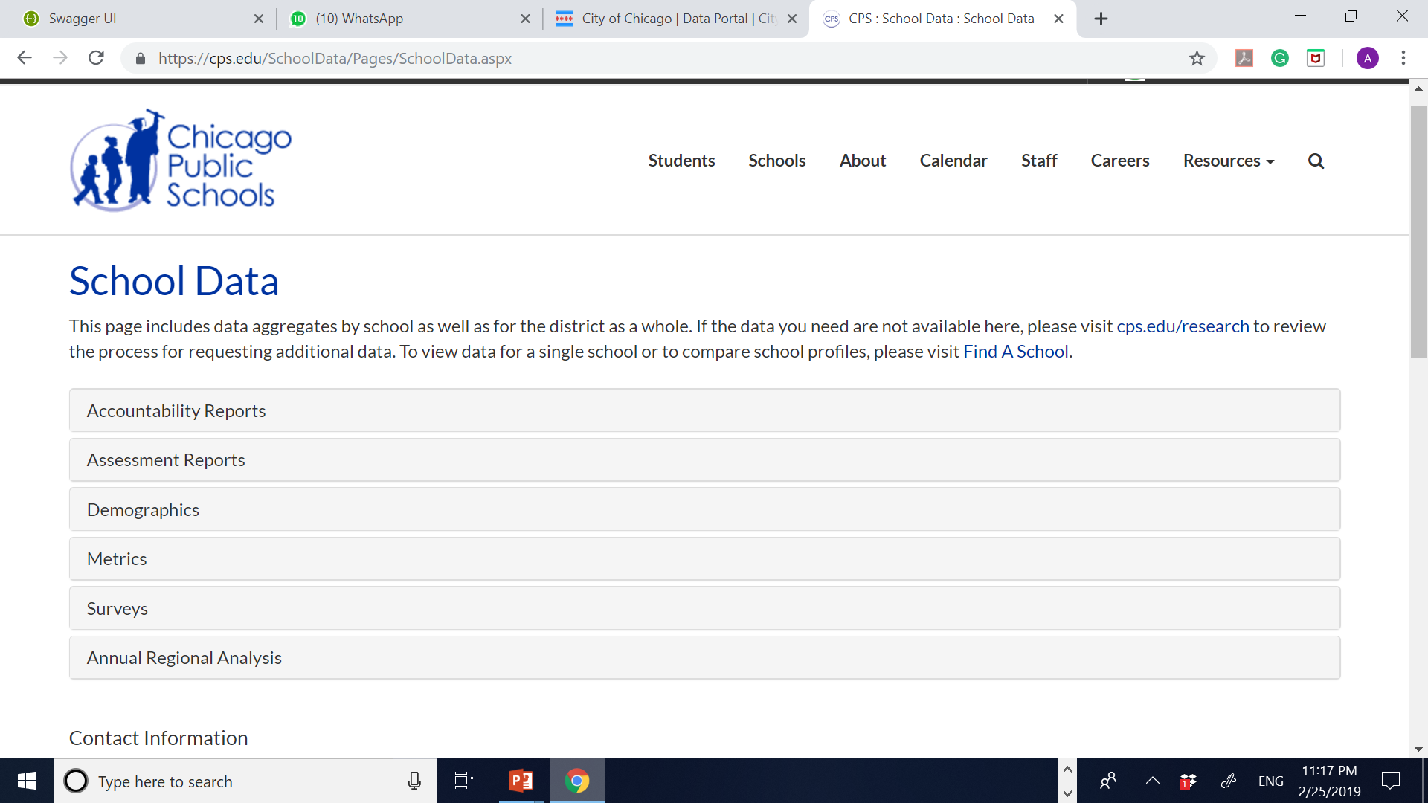
CHICAGO CITY – EDUCATION DIRECT DOWNLOADING

Slide 16
PRICE DATA: ZILLOW – WEB SCRAPPING

Slide 17
Live Demo

Slide 18
Lessons learnt
Researching on the market demand of the application including competition, literature review, pricing model.
Picking suitable criteria and indicators that define the requirement of the data.
Understanding how to use basic python commands and data structures like Numpy, pandas, matplotlib
Implementing data loading ,web scraping, cleaning of raw data, using the clean data and storing it into file.
Making use of file access and storing commands to read and write data to the file.
Using matplotlib package to make visualizations relevant to the data the application will provide the user.
The importance of team work as all of us put in a cummulative effort from the inception of the project to the realization to the final output application.

